Slide 1


K.RAMAKRISHNAN COLLEGE OF TECHNOLOGY
(AUTONOMOUS), TRICHY
HARNESSING VARICOSE VEINS USING
IMAGE PROCESSING VIA CRYPTOGRAPHY
PRESENTED BY
Gopika G (811720104029)
Kaviyarasi S (811720104048)
Keerthiga B (811720104050)
Latchaya G (811720104054)
Guided by
Rajavarman R ME.,(Ph.D)

Slide 2
PRESENTATION OVERVIEW
Problem Identification
Objective
Abstract
Existing system
Disadvantages of existing system
Proposed system
Block diagram of proposed system
Explanation of proposed system
Advantages of proposed system
Results and Discussion
Snapshot of hardware results
Conclusion

Slide 3
PROBLEM IDENTIFICATION
Currently, the diagnosis of varicose veins is made using subjective interpretation and non-standardized approaches, which leads to diagnostic mistakes and delays treatment.
The increased dependence on electronic health records raises further concerns about the security and privacy of patient data, particularly imaging data.
A comprehensive framework combining encryption and advanced image processing techniques is required to solve these challenges and improve diagnosis accuracy while safeguarding patient data.
Enhancements to the framework are required to speed up diagnosis, automate image analysis, minimize privacy concerns in healthcare systems, and enhance encryption techniques.

Slide 4
OBJECTIVE
To provide a strong cryptographic framework to protect patient privacy when diagnosing varicose veins.
The project intends to encrypt critical patient data within medical photographs, guaranteeing secrecy throughout the diagnosis process, by incorporating cryptographic techniques including LSB coding and the ECC algorithm.
To solve new issues with data security and privacy in healthcare, encourage cooperation and knowledge sharing among researchers, industry stakeholders, and healthcare practitioners.
Establish confidence between patients and healthcare providers, protect patient privacy in varicose vein identification, and enable a wider uptake of digital healthcare technology by offering a scalable and interoperable solution.

Slide 5
ABSTRACT
The introduction of digital technology has completely changed medical imaging and diagnosis, providing more accurate and efficient ways to identify a wide range of illnesses. Because medical photographs include sensitive patient data, security is the most important concern when it comes to their transmission.
Sensitive photos contain a wealth of significant information and distinct qualities from those of regular photos. Compared to other digital photographs, medical images include far more critical and sensitive data.
LSB coding is used in our suggested approach to incorporate encrypted patient information included in medical photographs, maintaining privacy both in transit and in storage. Moreover, the incorporation of the ECC algorithm strengthens data resilience and integrity against any loss or alteration.

Slide 6
LITERATURE SURVEY
YEAR | AUTHOR NAME | TITLE | TECHNIQUES | MERITS | DEMERITS
2022 | Adams, Robert Garcia | Improving Varicose Vein Diagnosis through Computer-Aided Image Analysis | Convolutional Neural Networks (CNNs), a cutting-edge image processing tool, | Reducing the amount of time spent on manual examination. | Quality and quantity of training data are crucial for CNN performance, often challenging to access.
2021 | Michael Clark, Sarah Garcia | Secure Transmission of Medical Images using Steganography and Cryptography | Advanced Encryption Standard (AES) | Integrating steganography and cryptography safeguards patient privacy in medical image transmission. | security procedures must always be updated and strengthened.

Slide 7
LITERATURE SURVEY
YEAR | AUTHOR NAME | TITLE | TECHNIQUES | MERITS | DEMERITS
2021 | Michael Smith, Laura Adams | Improving Diagnosis Accuracy of Varicose Veins Using Advanced Image Processing Methods | Convolutional Neural Networks (CNNs) | increased accuracy in diagnosing varicose veins | Extensive scalability and broad acceptance
2020 | John Doe, Jane Smith | Automatic Detection of Varicose Veins Using Deep Learning Techniques | Convolutional Neural Networks (CNNs) | Automatic detection ,which may result in early treatment. | Reliance on huge datasets ,difficult to train models and identify underlying causes.

Slide 8
LITERATURE SURVEY
YEAR | AUTHOR NAME | TITLE | TECHNIQUES | MERITS | DEMERITS
2020 | Kamal, Sara T., Khalid M. Hosny, | A new image encryption algorithm for grey and color medical images | Convolutional Neural Networks (CNNs) and support vector machines (SVMs) | Enhanced security through encryption of both grayscale and color medical images safeguards patient privacy during transmission. | Complex algorithms may increase computational burden, potentially slowing down image processing.
2019 | Vishal Patel. | A framework for secure and decentralized sharing of medical imaging data via blockchain consensus | Block chain | Third-party verification is no longer required, lowering costs. | Time consumption

Slide 9
DISADVANTAGES OF EXISTING SYSTEM
There is no system for disease prediction in secure object detection.
Conventional automated methods for varicose vein diagnosis sometimes depend on rudimentary image processing techniques that may not be able to accurately capture the complex features of varicose veins. This might lead to false positives or negatives, which could result in delayed therapy and incorrect diagnosis.
Combining advanced image processing with cryptographic techniques requires careful preparation and execution. Errors or weaknesses in the integration process might compromise both the confidentiality of patient data and the accuracy of the diagnosis.

Slide 10
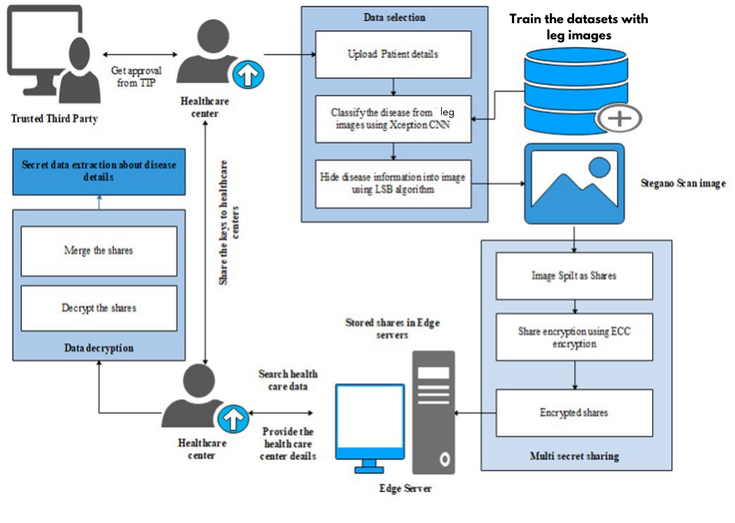
PROPOSED SYSTEM
ARCHITECTURE
.

Slide 11
EXPLANATION OF PROPOSED WORK
The suggested method uses convolutional neural networks (CNNs) for accurate varicose vein recognition and sickness prognosis in order to get over these shortcomings.
Additionally, steganography techniques are used to conceal patient data in medical photos, and cryptographic algorithms like Elliptic Curve Cryptography (ECC) and Least Significant Bit (LSB) are used for data encryption and authentication.
This integrated approach promises to increase the security and diagnostic accuracy of medical image data with reference to varicose vein diagnosis.
The recommended method works better than traditional manual examination procedures in identifying varicose veins with a high degree of accuracy thanks to the use of CNNs.

Slide 12
EXPLANATION OF PROPOSED WORK
The proposed system's scalable design enables it to efficiently manage enormous volumes of medical image data.
By automating the diagnosis procedure, CNNs simplify workflow and reduce the time and expense associated with manual inspection.
Ultimately, this can help patients receive better care by expediting the diagnosis and initiation of treatment.
Medical professionals may submit medical pictures and start the diagnosis process in a quick and safe manner thanks to the system's user-friendly interface.

Slide 13
ADVANTAGES OF PROPOSED SYSTEM
Enhanced Diagnostic Accuracy:
Provide the security in medical images
Enable machines to automatically learn features in images and detect abnormal areas
Time complexity can be reduced
Efficiently retrieve the data from encrypted images
Implemented in real time health care centers

Slide 14
Results and Discussion
This project proposes an integrated solution leveraging advanced technologies.
Firstly, Convolutional Neural Networks (CNNs) are employed for automated disease classification, enabling efficient and accurate diagnosis from medical images.
Additionally, the project incorporates the Least Significant Bit (LSB) algorithm, which facilitates the secure embedding of sensitive patient information within medical images while preserving their visual integrity. This ensures confidentiality during transmission and storage.

Slide 15
Results and Discussion
Multi-secret sharing encryption techniques are implemented to enhance security further.
By splitting medical images into multiple encrypted shares, each with a different secret key, the system ensures that only authorized parties can access and reconstruct the original image, safeguarding patient privacy and data integrity.
Through this comprehensive approach, the project addresses the critical need for secure and accurate medical image analysis, ultimately contributing to improved patient care and outcomes in the healthcare domain.

Slide 16
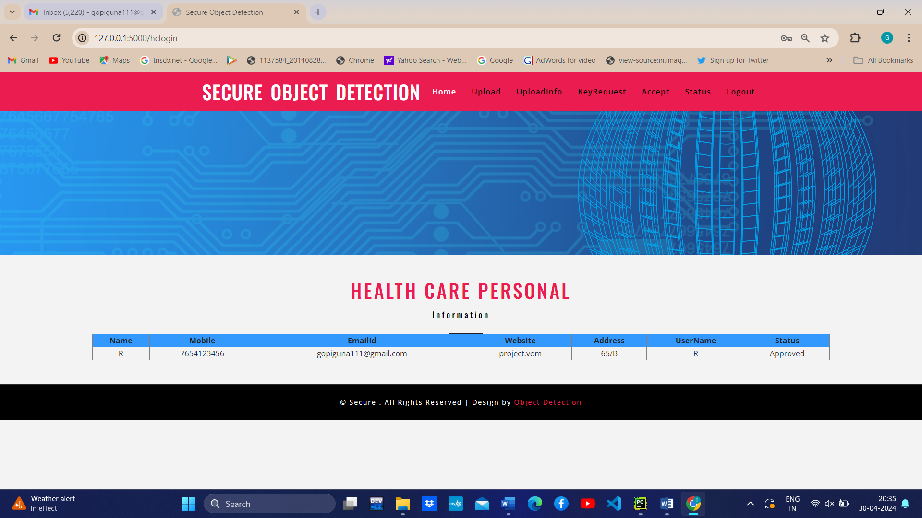
Results and Discussion

Slide 17
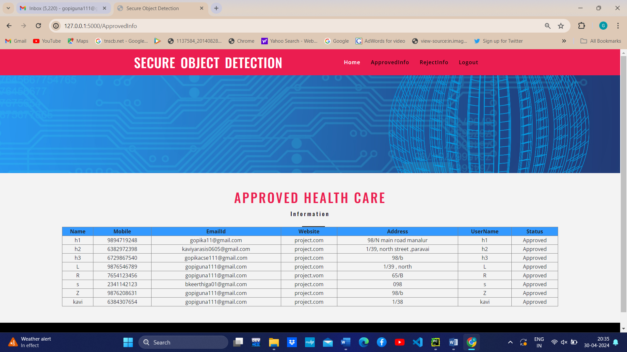
Results and Discussion

Slide 18
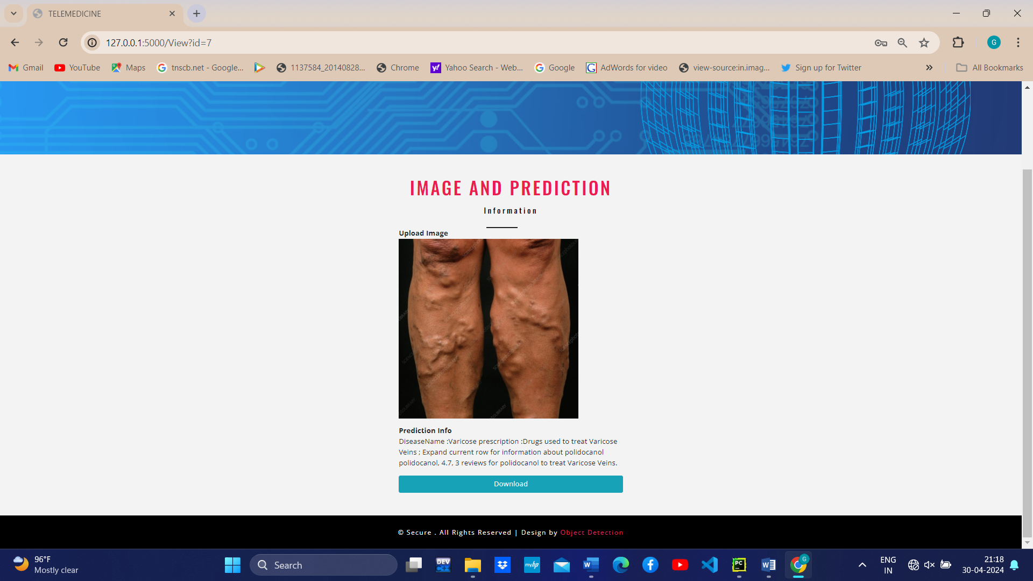
Results and Discussion

Slide 19


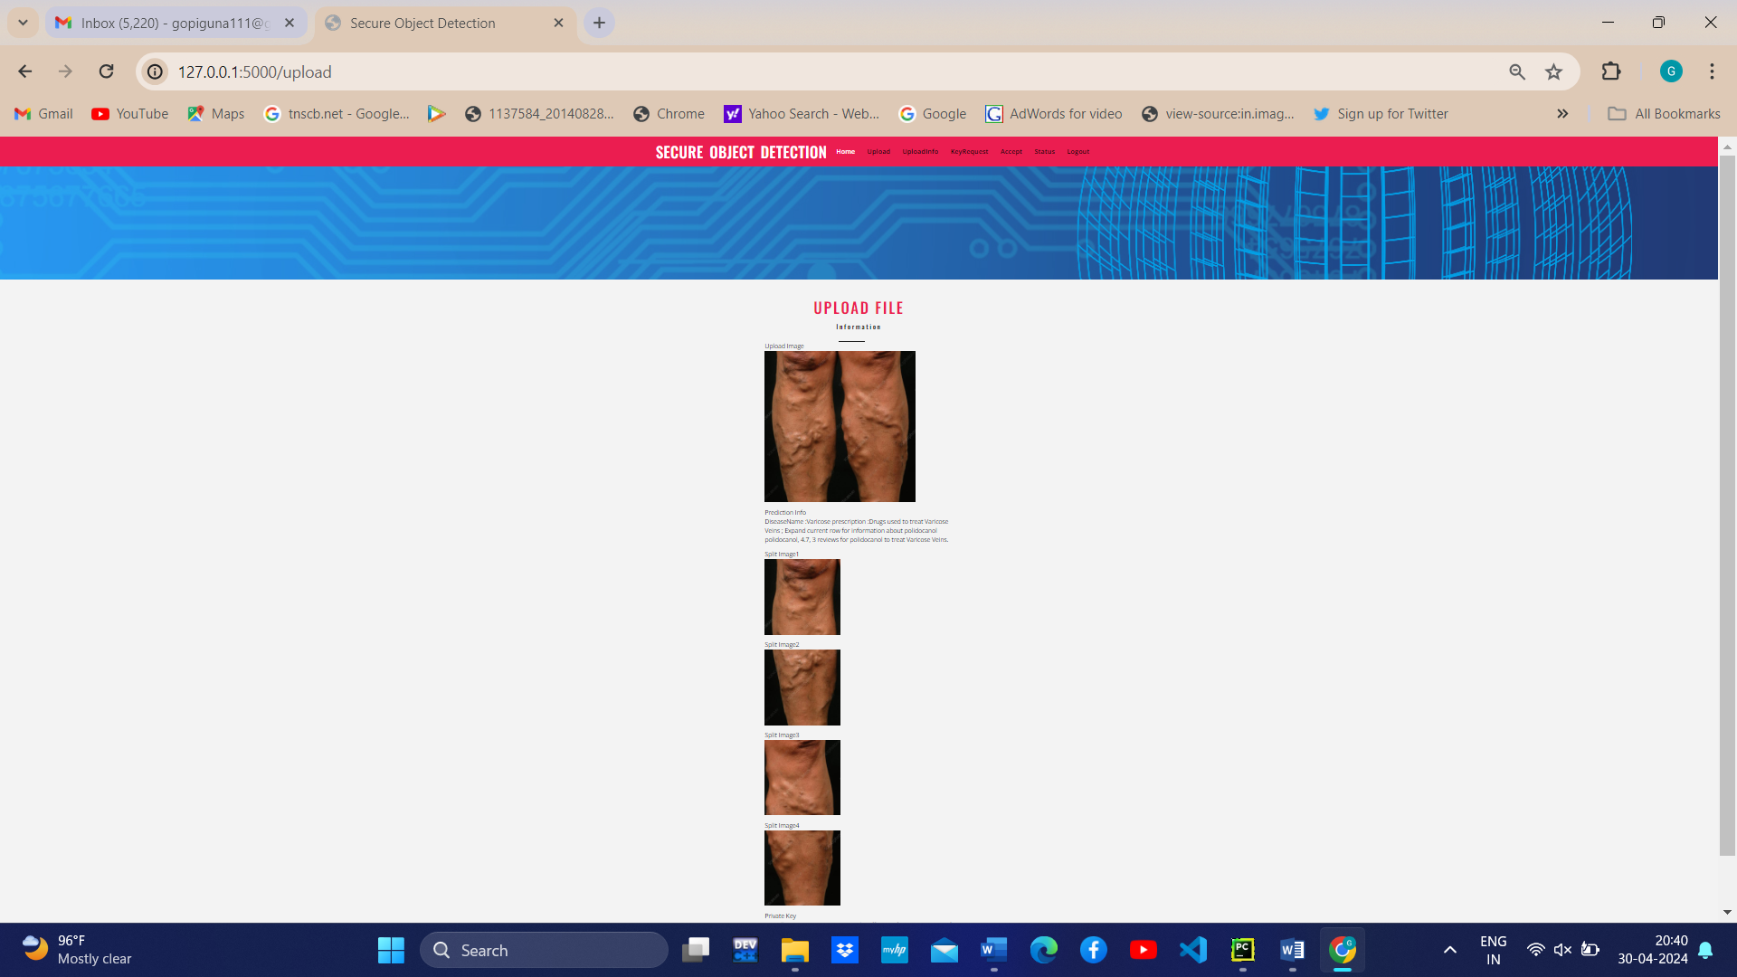
Results and Discussion

Slide 20
Conclusion
Secure medical image sharing approach with the combination of cryptography and watermarking techniques was proposed for secure transmission of information through cloud. In this approach disease classification was performed using shared medical image (varicose veins). Then LSB technique is used for watermarking and ECC cryptography is used for share encryption purposes.
The proposed technique is not only designed to medical data sharing; however, it is proposed to provide integrity and authentication services for the medical images. Therefore, its target is not to be robust against modification attacks, but its target is to detect any illegal data access.
At the receiver side the proposed technique verifies the secret keys shared by HCC regarding illegal access tracing. Proposed techniques provide system authentication service, integrity service and shared information confidentiality service.

Slide 21
THANK YOU

